Slide 1
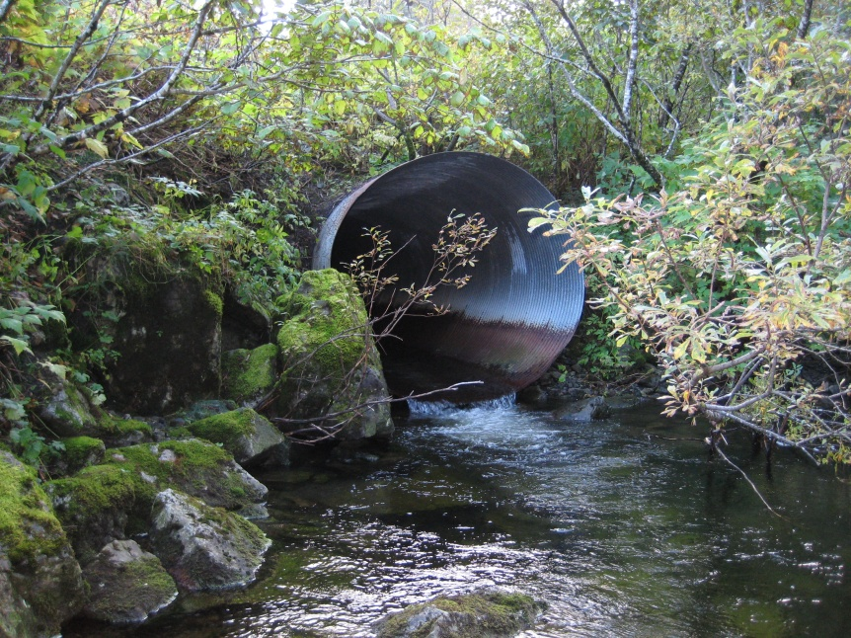
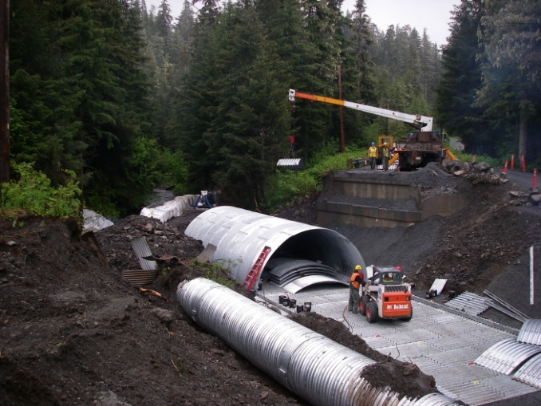
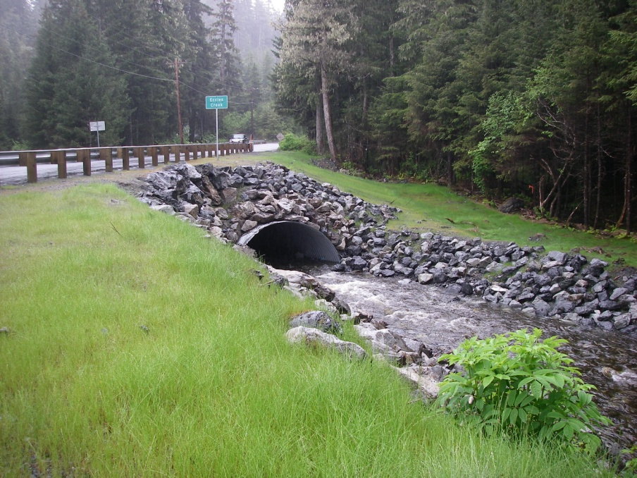
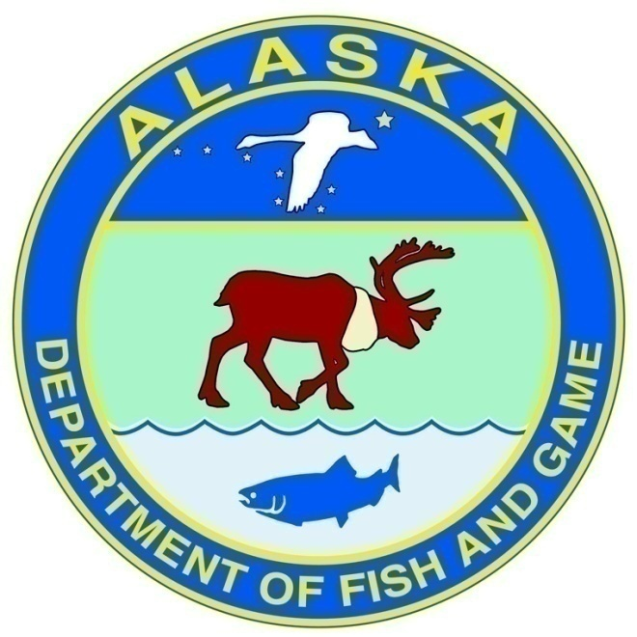
Fish Protection Laws in Alaska
ADF&G Statutory Authority
2018 Moolin Seminar
Rural and Arctic Construction in Alaska
November 21, 2018
Anchorage, AK
Habitat’s mission is to protect Alaska’s valuable fish and wildlife resources and their habitats as Alaska’s population and economy continue to expand.
Notes:
Our T16 authority is the foundation for most of the work we do everyday and plays an important role in protecting fish habitat throughout the state.
*Eccles Creek culvert replacement in Cordova, 2010

Slide 2
ADF&G Statutory Authority
Fish Habitat Protection
THE FISHWAY ACT
  AS 16.05.841
ANADROMOUS FISH ACT
  AS 16.05.871
SPECIAL AREA PERMITTING
  5 AAC 95.700
AQUATIC RESOURCE PERMIT
  Required for handling or transporting fish during dewatering or diversion (Division of Sport Fish)
Notes:
Alaska’s early fish protection laws have helped us avoid many of the major issues related to fish passage and habitat loss or degradation seen in many areas of the lower 48. As early as 1919, the territorial government could require fishways prior to construction of dams or other obstructions. By 1959, the legislature enacted a Fish and Game Code included statutory protections for fish passage and later fish habitat.
In addition to the authorities delegated to the Division of Habitat for fish passage and fish habitat protection, the Division of Sport Fish also has authority to regulate the handling and transport of fish. A Fish Resource Permit is required during construction for most fish passage projects.
Today I will be focusing on the The Fishway Act and the Anadromous Fish Act, but feel free to stop me later if you have questions related to fish resource permits.

Slide 3
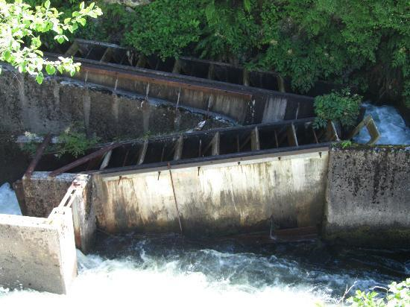
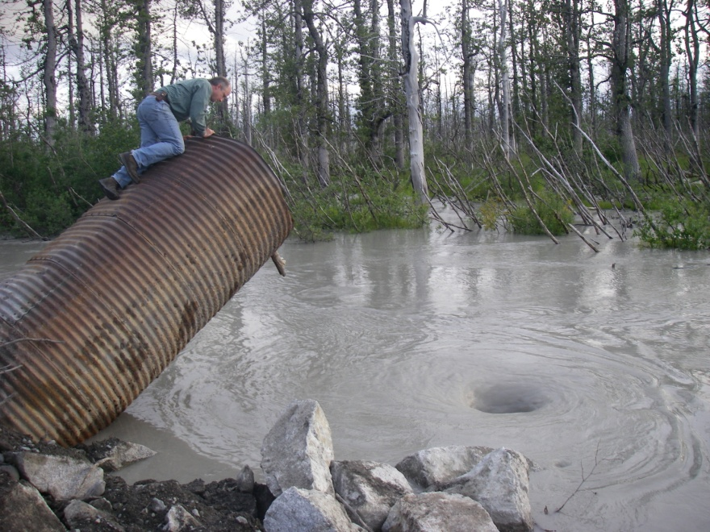
Fishway Act
AS 16.05.841 requires that any obstruction built across fish-bearing waters will provide for fish passage
Applies to all fish bearing streams (resident and anadromous) and all fish species.
Requires long-term commitment to operation & maintenance
Applies to fish passage only

Slide 4
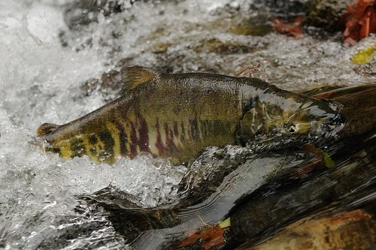
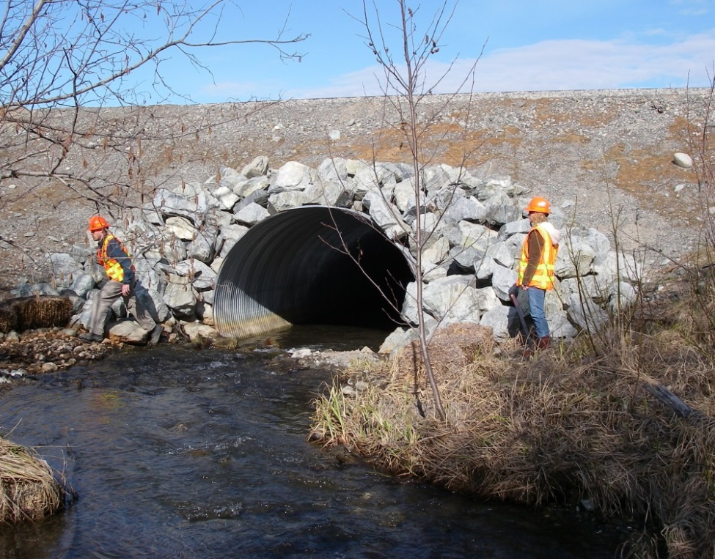
Anadromous Fish Act
Strengths
Applies to any activity
Applies to any life stage
Limitations
Jurisdiction limited to below OHW
Waterbody must be in AWC
Freshwater only

Slide 5
Activities That Typically Require Fish Habitat Permits
Culvert/Bridge/Ford installation, maintenance, and restoration
Stream crossings – vehicles/pipelines/power lines
Streambank repair/construction
Stream diversions/removals
Water withdrawals – road work/drilling/mining/ice roads
Material Sites
Dam construction/maintenance
Run of the river hydro projects (no dam)
Research projects – fish weir installation/operation
Dock/Boat ramp construction
Blasting

Slide 6
Fish Habitat Permits
Applicant submits plans to ADF&G
Habitat Biologist reviews and consults area staff
May be permitted as proposed or modified during review process
Timeline for review…4-6 weeks
Emergency exemptions
  AS 16.05.891
  Verbal/email approval
  Follow up with formal permit
Typical Stipulations
  Timing
  Diversion/Bypass Pumping
  Sediment Control
  Reveg/Stabilization
  Fish Passage
  Notification

Slide 7
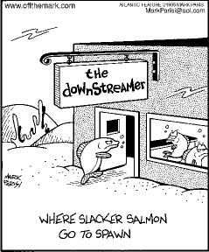
Questions?
Ron Benkert
ADF&G Habitat
Palmer Area Office
(907) 267-2172
ronald.benkert@alaska.gov
Notes:
Questions?

